Slide 1
Introduction to NLP
UNIT 1

Slide 2
Books and Materials
Reference Books
Daniel Jurafsky and James H. Martin. 2009. Speech and Language Processing: An Introduction to Natural Language Processing, Speech Recognition, and Computational Linguistics. 2nd edition. Prentice-Hall.
Christopher D. Manning and Hinrich Schütze. 1999. Foundations of Statistical Natural Language Processing. MIT Press.
Lecture Material Lecture Slides IPython Notebooks
Week 1: Lecture 1
3 / 9

Slide 3
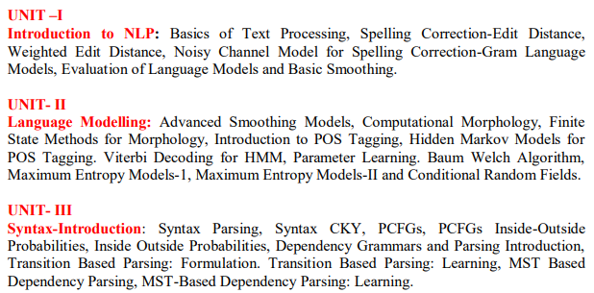
Course Contents: Unit 1-3
Week 1: Lecture 1

Slide 4
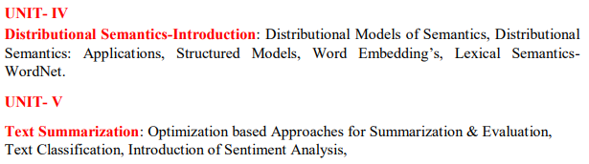
Course Contents: Unit 4-5
Week 1: Lecture 1

Slide 5
Why study NLP?
Text is the largest repository of human knowledge
news articles, web pages, scientific articles, patents, emails, government documents ....
7 / 9

Slide 6
Why study NLP?
Text is the largest repository of human knowledge
news articles, web pages, scientific articles, patents, emails, government documents ....
Tweets, Facebook posts, comments, Quora ...
Week 1: Lecture 1
7 / 9

Slide 7
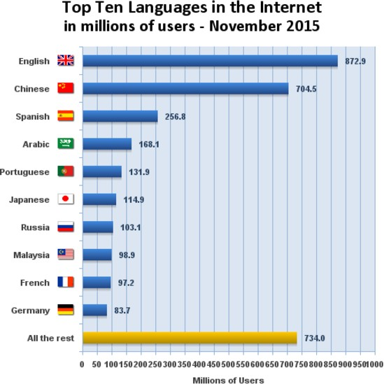
Why study NLP?
¹ You could not understand the majority of the world’s data
¹Source: Internet world statistics

Slide 8
What is NLP?
Fundamental and Scientific Goal
Deep understanding of broad language
Engineering Goal
Design, implement, and test systems that process natural languages for practical applications
Module 1: Lecture 2

Slide 9
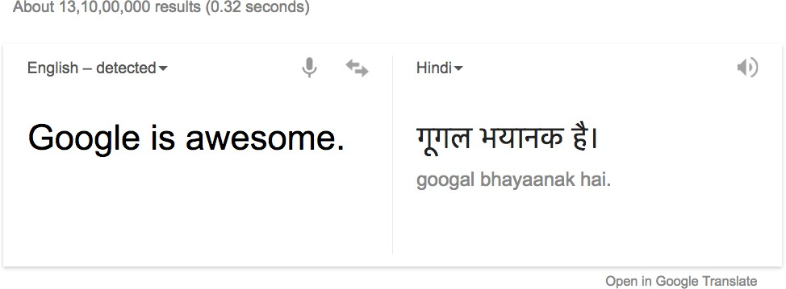
Goals can be very ambitious: Good quality translation
Module 1: Lecture 2

Slide 10
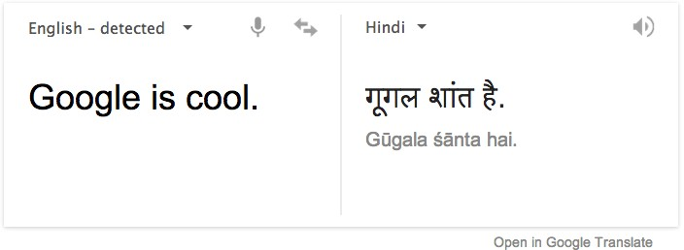
Goals can be very ambitious: Good quality translation
Module 1: Lecture 2

Slide 11
Well, even humans have made blunders
Pepsi Chinese blunder
“Come alive with the Pepsi Generation”, when translated into Chinese meant, “Pepsi brings your relatives back from the dead.”
5 / 14

Slide 12
Well, even humans have made blunders
Pepsi Chinese blunder
“Come alive with the Pepsi Generation”, when translated into Chinese meant, “Pepsi brings your relatives back from the dead.”
KFC’s Chinese blunder
KFC’s slogan, “Finger lickin’ good”, when translated into Chinese meant “We’ll eat your fingers off.”
Module 1: Lecture 2
5 / 14

Slide 13

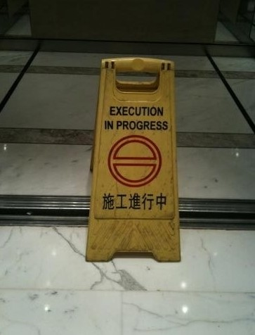
Well, even humans ...
Module 1: Lecture 2

Slide 14
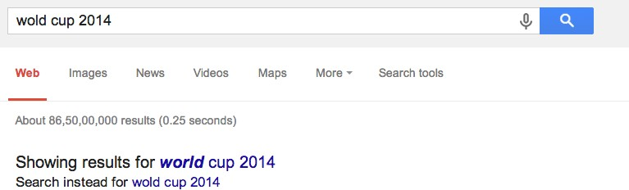
And Goals Can be Practical: Auto Completion
Module 1: Lecture 2

Slide 15
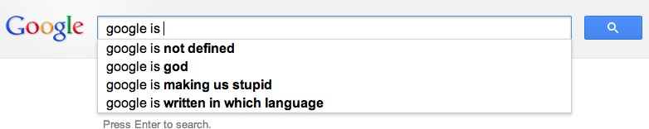
And Goals can be Practical: Search Engines
Module 1: Lecture 2

Slide 16
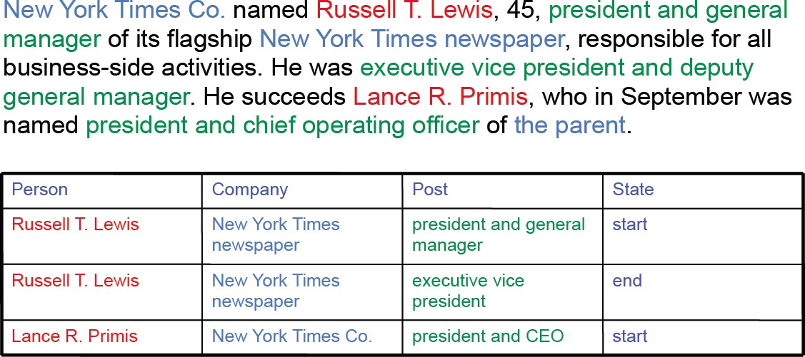
And Goals can be Practical: Information Extraction
Module 1: Lecture 2

Slide 17
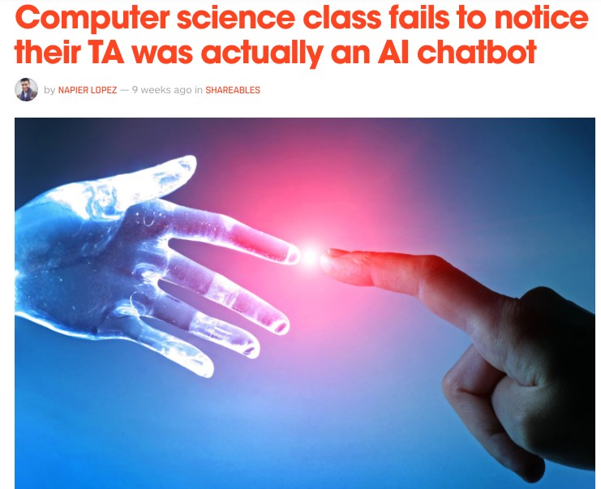
And Goals can be Practical: Domain-specific Chatbots
Module 1: Lecture 2

Slide 18
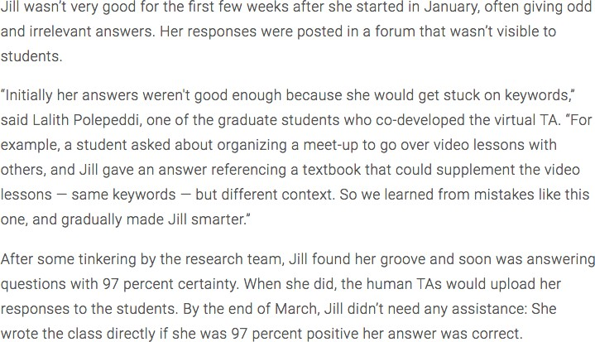
And Goals can be Practical: Domain-specific Chatbots
1
¹http://www.news.gatech.edu/2016/05/09/artificial-intelligence-course-creates-ai-teaching-assist
Module 1: Lecture 2

Slide 19

And Goals can be Practical: Sentiment Analysis
Module 1: Lecture 2

Slide 20
Other Goals
Spam detection
Machine Translation services on the Web Text Summarization
. . .
Module 1: Lecture 2
14 / 14

Slide 21
Other Goals
Spam detection
Machine Translation services on the Web Text Summarization
. . .
Natural Language Technology not yet perfect
But still good enough for several useful applications
Module 1: Lecture 2
14 / 14

Slide 22
Why is NLP hard?
Week 1: Lecture 3

Slide 23
Why is NLP hard?
Lexical Ambiguity
Will Will will Will’s will?
Rose rose to put rose roes on her rows of roses.
Buffalo buffalo Buffalo buffalo buffalo buffalo Buffalo buffalo.
→ Buffaloes from Buffalo, NY, whom buffaloes from Buffalo bully, bully buffaloes from Buffalo.
Week 1: Lecture 3
2 / 16

Slide 24
Why is NLP hard?
Language ambiguity: Structural
The man saw the boy with the binoculars. Flying planes can be dangerous.
Hole found in the room wall; police are looking into it.
Language imprecision and vagueness
It is very warm here.
Q: Did your mother call your aunt last night? A: I’m sure she must have.
Week 1: Lecture 3
3 / 16

Slide 25
But that’s the fun part of it
Why is the teacher wearing sun-glasses?
...
Because the class is so bright.
4 / 16

Slide 26
Ambiguities
News Headlines
Hospitals Are Sued by 7 Foot Doctors
Stolen Painting Found by Tree Teacher Strikes Idle Kids
Week 1: Lecture 3

Slide 27
Ambiguity is pervasive
Find at least 5 meanings of this sentence:
⁾ I made her duck
I cooked duck for her
I cooked duck belonging to her
I created the (artificial) duck, she owns
I caused her to quickly lower her head or body
I waved my magic wand and turned her into a duck
He ducks to carry the ducks
Week 1: Lecture 3
6 / 16

Slide 28
Ambiguity is pervasive
Syntactic Category
‘Duck’ can be a noun or verb
‘her’ can be a possessive (‘of her’) or dative (‘for her’) pronoun
Word Meaning
‘make’ can mean ‘create’ or ‘cook’
Week 1: Lecture 3
7 / 16

Slide 29
Ambiguity is pervasive
Grammar
make can be
Transitive: (verb with a noun direct object)
Ditransitive: (verb has 2 noun objects)
Action-transitive: (verb has a direct object + verb)
Phonetics
I’m eight or duck
I’m aid her duck
Week 1: Lecture 3
8 / 16

Slide 30
Ambiguity is Explosive
I saw the man with the telescope. 2 parses
I saw the man on the hill with the telescope. 5 parses
I saw the man on the hill in Texas with the telescope. 14 parses
I saw the man on the hill in Texas with the telescope at noon. 42 parses
I saw the man on the hill in Texas with the telescope at noon on Monday.
132 parses
Week 1: Lecture 3
9 / 16

Slide 31
Why is Language Ambiguous?
The goal in the production and comprehension of natural language is
efficient communication.
Allowing resolvable ambiguity
⁾ permits shorter linguistic expressions
⁾ avoids language being overly complex
Language relies on people’s ability to use their knowledge and inference abilities to properly resolve ambiguities
Week 1: Lecture 3
10 / 16

Slide 32
Natural Languages vs. Computer Languages
Ambiguity is the primary difference between natural and computer languages.
Formal programming languages are designed to be unambiguous
⁾ Formal programming languages can be defined by a grammar that produces a unique parse for each sentence in the language.
Programming languages are also designed for efficient (deterministic) parsing.
Week 1: Lecture 3
11 / 16

Slide 33
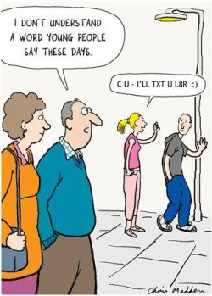
Why else is NLP hard?
Week 1: Lecture 3

Slide 34
Why else is NLP hard?
Non-standard English
Great job @justinbieber! Were SOO PROUD of what youve accomplished! U taught us 2 #neversaynever & you yourself should never give up either
Segmentation Issues
the New York-New Haven Railroad
the [New] [York-New] [Haven] [Railroad]
the [New York]-[New Haven] [Railroad]
Week 1: Lecture 3
13 / 16

Slide 35
Why else is NLP hard?
Idioms
dark horse
Ball in your court Burn the midnight oil
neologisms
unfriend retweet
Google/Skype/photoshop
Week 1: Lecture 3
14 / 16

Slide 36
Why is NLP hard?
New Senses of a word
That’s sick dude!
Giants ... multinationals, conglomerates, manufacturers
15 / 16

Slide 37
Why is NLP hard?
New Senses of a word
That’s sick dude!
Giants ... multinationals, conglomerates, manufacturers
Tricky Entity Names
Where is A Bug’s Life playing ...
Let It Be was recorded ...
Week 1: Lecture 3
15 / 16

Slide 38
What we do in NLP?
Tools Required
Knowledge about language Knowledge about the world
A way to combine knowledge resources
How is it generally done?
Probabilistic models built from language data
⁾ P(“maison” → “house”) is high
⁾ P(I saw a van) > P(eyes awe of an)
Extracting rough text features does half the job.
Week 1: Lecture 3
16 / 16

Slide 39
Text Processing: Basics
Week 1: Lecture 5

Slide 40
Text processing: tokenization
What is Tokenization?
Tokenization is the process of segmenting a string of characters into words.
Depending on the application in hand, you might have to perform sentence segmentation as well.
Week 1: Lecture 5

Slide 41
Sentence Segmentation
The problem of deciding where the sentences begin and end.
Challenges Involved
While ‘!’, ‘?’ are quite unambiguous
Period “.” is quite ambiguous and can be used additionally for
⁾ Abbreviations (Dr., Mr., m.p.h.)
⁾ Numbers (2.4%, 4.3)
Approach: build a binary classifier
For each “.”
Decides EndOfSentence/NotEndOfSentence
Classifiers can be: hand-written rules, regular expressions, or machine learning
Week 1: Lecture 5
3 / 26

Slide 42
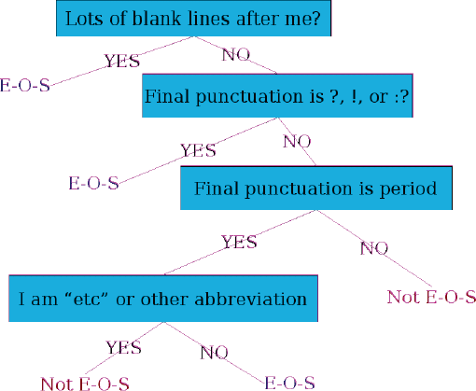
Sentence Segmentation: Decision Tree Example
Decision Tree: Is this word the end-of-sentence (E-O-S)?
Week 1: Lecture 5
4 / 26

Slide 43
Implementing Decision Trees
Just an if-then-else statement
Choosing the features is more important
For numeric features, thresholds are to be picked
With increasing features including numerical ones, difficult to set up the structure by hand
Decision Tree structure can be learned using machine learning over a training corpus
Basic Idea
Usually works top-down, by choosing a variable at each step that best splits the set of items.
Popular algorithms: ID3, C4.5, CART
Week 1: Lecture 5
6 / 26

Slide 44
Other Classifiers
The questions in the decision tree can be thought of as features, that could be exploited by any other classifier:
Support Vector Machines Logistic regression Neural Networks
Week 1: Lecture 5
7 / 26

Slide 45
Word Tokenization
What is Tokenization?
Tokenization is the process of segmenting a string of characters into words.
I have a can opener; but I can’t open these cans.
Word Token
An occurrence of a word
For the above sentence, 11 word tokens.
Word Type
A different realization of a word
For the above sentence, 10 word types.
Week 1: Lecture 5
8 / 26

Slide 46
NLTK Toolkit (Python) Stanford CoreNLP (Java) Unix Commands
Tokenization in practice

Slide 47
Word Tokenization
Issues in Tokenization
Finland’s → Finland Finlands Finland’s ?
What’re, I’m, shouldn’t → What are, I am, should not ? San Francisco → one token or two?
m.p.h. → ??
For information retrieval, use the same convention for documents and queries
Week 1: Lecture 5
10 / 26

Slide 48
Handling Hyphenation
Hyphens can be
End-of-Line Hyphen
Used for splitting whole words into part for text justification.
This paper describes MIMIC, an adaptive mixed initia-tive spoken dialogue system that provides movie show-time information.
Lexical Hyphen
Certain prefixes are offen written hyphenated, e.g. co-, pre-, meta-, multi-, etc.
Sententially Determined Hyphenation
Mainly to prevent incorrect parsing of the phrase. Some possible usages: Noun modified by an ‘ed’-verb: case-based, hand-delivered
Entire expression as a modifier in a noun group: three-to-five-year direct marketing plan
Week 1: Lecture 5
11 / 26

Slide 49
Language Specific Issues: French and German
French
l’ensemble: want to match with un ensemble
German
Noun coumpounds are not segmented
Lebensversicherungsgesellschaftsangestellter ‘life insurance company employee’
Compound splitter required for German information retrieval
Week 1: Lecture 5
12 / 26

Slide 50
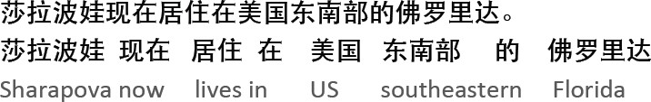
Language Specific Issues: Chinese and Japanese
No space between words
Week 1: Lecture 5
13 / 26

Slide 51
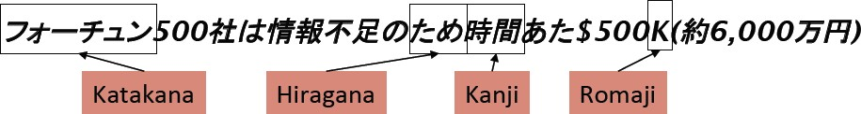
Language Specific Issues: Chinese and Japanese
No space between words
Japanese: further complications with multiple alphabets intermingled.
Week 1: Lecture 5
13 / 26

Slide 52
Language Specific Issues: Sanskrit
satyam. bru¯ ya¯ tpriyam. bru¯ ya¯ nnabru¯ ya¯ tsatyamapriyam. priyam. cana¯ n.rtambru¯ ya¯ d- es. adharmah. sana¯ tanah. .
“One should tell the truth, one should say kind words; one should neither tell harsh truths, nor flattering lies; this is a rule for all times.”
Week 1: Lecture 5
14 / 26

Slide 53
Language Specific Issues: Sanskrit
satyam. bru¯ ya¯ tpriyam. bru¯ ya¯ nnabru¯ ya¯ tsatyamapriyam. priyam. cana¯ n.rtambru¯ ya¯ d- es. adharmah. sana¯ tanah. .
“One should tell the truth, one should say kind words; one should neither tell harsh truths, nor flattering lies; this is a rule for all times.”
Segmented Text:
satyam bru¯ ya¯ t priyam bru¯ ya¯ t na bru¯ ya¯ t satyam apriyam priyam ca na an.rtam bru¯ ya¯ t es. ah. dharmah. sana¯ tanah. .
Week 1: Lecture 5
14 / 26

Slide 54
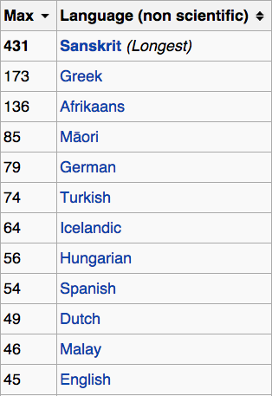
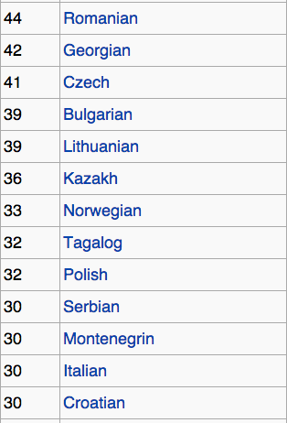
Longest Words
Week 1: Lecture 5

Slide 55
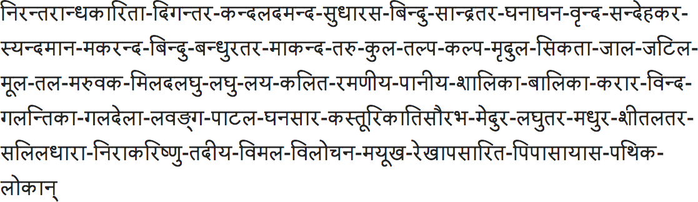
Longest Words
Compound word composed of 431 letters, from the Varada¯ mbika¯ Parin˙aya Campu¯ by Tirumala¯ mba
Week 1: Lecture 5

Slide 56
Word Tokenization in Chinese or Sanskrit
Also called ‘Word Segmentation’.
Greedy Algorithm for Chinese
Maximum Matching (Greedy Algorithm)
Start a pointer at the beginning of the string
Find the largest word in dictionary that matches the string starting at pointer
Move the pointer over the word in string
Think of the cases when word segmentation would be required for English Text.
Week 1: Lecture 5
17 / 26

Slide 57
Word Tokenization in Chinese or Sanskrit
Also called ‘Word Segmentation’.
Greedy Algorithm for Chinese
Maximum Matching (Greedy Algorithm)
Start a pointer at the beginning of the string
Find the largest word in dictionary that matches the string starting at pointer
Move the pointer over the word in string
Think of the cases when word segmentation would be required for English Text.
Finding constituent words in a compound hashtags: #ThankYouSachin, #musicmonday etc.
Week 1: Lecture 5
17 / 26

Slide 58
Text Segmentation for Sanskrit
General assumption behind the design
Sentences from Classical Sanskrit may be generated by a regular relation R of the Kleene closure W∗ of a regular set W of words over a finite alphabet Σ.
W: vocabulary of (inflected) words (padas) and
R: sandhi
Analysis of a sentence
A candidate sentence w is analyzed by inverting relation R to produce a finite sequence w₁, w₂,...w_{n} of word forms, together with a proof that
w ∈ R(w₁ · w₂... · w_{n}).
Week 1: Lecture 5
18 / 26

Slide 59
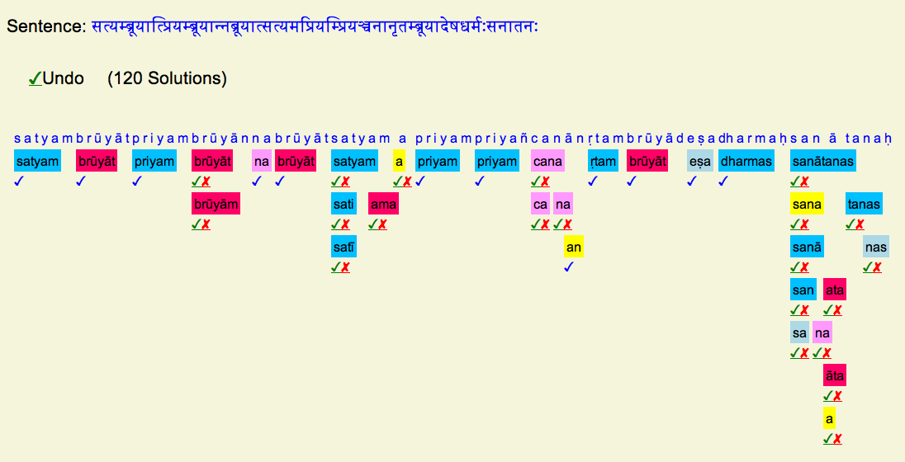
Word Segmentation in Sanskrit
Week 1: Lecture 5

Slide 60
Normalization
Why to “normalize”?
Indexed text and query terms must have the same form.
U.S.A. and USA should be matched
We implicitly define equivalence classes of terms
Week 1: Lecture 5
20 / 26

Slide 61
Case Folding
Reduce all letters to lower case Possible exceptions (Task dependent):
⁾ Upper case in mid sentence, may point to named entities (e.g. General Motors)
⁾ For MT and inforamtion extraction, some cases might be helpful (US vs.
us)
Week 1: Lecture 5
21 / 26

Slide 62
Lemmatization
Reduce inflections or variant forms to base form:
⁾ am, are, is → be
⁾ car, cars, car’s, cars’ → car
Have to find the correct dictionary headword form
Week 1: Lecture 5

Slide 63
Morphology
Morphology studies the internal structure of words, how words are built up from smaller meaningful units called morphemes
Morphemes are divided into two categories
Stems: The core meaning bearing units
Affixes: Bits and pieces adhering to stems to change their meanings and grammatical functions
⁾ Prefix: un-, anti-, etc (a-, ati-, pra- etc.)
⁾ Suffix: -ity, -ation, etc (-taa, -ke, -ka etc.)
⁾ Infix: ‘n’ in ‘vindati’ (he knows), as contrasted with vid (to know).
Week 1: Lecture 5
23 / 26

Slide 64
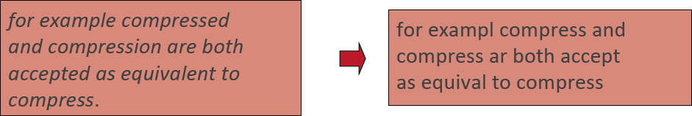
Stemming
Reducing terms to their stems, used in information retrieval Crude chopping of affixes
⁾ language dependent
⁾ automate(s), automatic, automation all reduced to automat
Week 1: Lecture 5
24 / 26

Slide 65
Porter’s algorithm
Step 1a
sses → ss (caresses → caress) ies → i (ponies → poni)
ss → ss (caress → caress) s → φ (cats → cat)
Week 1: Lecture 5
25 / 26

Slide 66
Porter’s algorithm
Step 1a
sses → ss (caresses → caress) ies → i (ponies → poni)
ss → ss (caress → caress) s → φ (cats → cat)
Step 1b
(*v*)ing → φ (walking → walk, king →
Week 1: Lecture 5
25 / 26

Slide 67
Porter’s algorithm
Step 1a
sses → ss (caresses → caress) ies → i (ponies → poni)
ss → ss (caress → caress) s → φ (cats → cat)
Step 1b
(*v*)ing → φ (walking → walk, king → king) (*v*)ed → φ (played → play)
Week 1: Lecture 5
25 / 26

Slide 68
Porter’s algorithm
Step 2
ational → ate (relational → relate) izer → ize (digitizer → digitize) ator → ate (operator → operate)
Week 1: Lecture 5
26 / 26

Slide 69
Porter’s algorithm
Step 2
ational → ate (relational → relate) izer → ize (digitizer → digitize) ator → ate (operator → operate)
Step 3
al → φ (revival → reviv)
able → φ (adjustable → adjust) ate → φ (activate → activ)
Week 1: Lecture 5
26 / 26

Slide 70
Spelling Correction: Edit Distance
Week 2: Lecture 1
70 / 20

Slide 71
Spelling Correction
I am writing this email on behaf of ...
The user typed ‘behaf’.
Which are some close words?
behalf
behave
....
Isolated word error correction
Pick the one that is closest to ‘behaf’
How to define ‘closest’? Need a distance metric
The simplest metric: edit distance
Week 2: Lecture 1
2 / 20

Slide 72
Edit Distance
The minimum edit distance between two strings Is the minimum number of editing operations
⁾ Insertion
⁾ Deletion
⁾ Substitution
Week 2: Lecture 1
3 / 20

Slide 73

Minimum Edit Distance
Example
Edit distance from ‘intention’ to ‘execution’
Week 2: Lecture 1
4 / 20

Slide 74
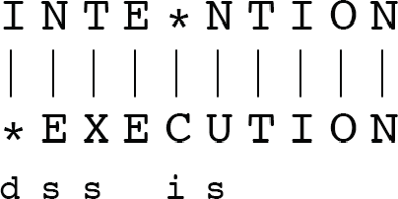
Minimum Edit Distance
Week 2: Lecture 1
5 / 20

Slide 75
Minimum Edit Distance
If each operation has a cost of 1 (Levenshtein)
⁾ Distance between these is 5
Week 2: Lecture 1
5 / 20

Slide 76
Minimum Edit Distance
If each operation has a cost of 1 (Levenshtein)
⁾ Distance between these is 5
If substitution costs 2 (alternate version)
⁾ Distance between these is 8
Week 2: Lecture 1
5 / 20

Slide 77
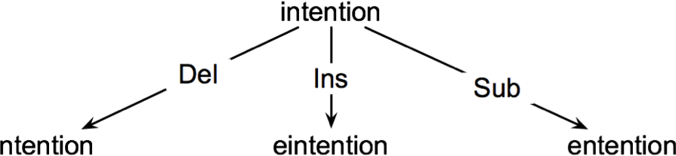
How to find the Minimum Edit Distance?
Searching for a path (sequence of edits) from the start string to the final string:
Initial state: the word we are transforming
Operators: insert, delete, substitute
Goal state: the word we are trying to get to
Path cost: what we want to minimize: the number of edits
Week 2: Lecture 1
6 / 20

Slide 78
Defining Minimum Edit Distance Matrix
For two strings
X of length n Y of length m
We define D(i, j)
the edit distance between X[1..i] and Y[1..j]
i.e., the first i characters of X and the first j characters of Y
Thus, the edit distance between X and Y is D(n, m)
Week 2: Lecture 1
8 / 20

Slide 79
Computing Minimum Edit Distance
Dynamic Programming
A tabular computation of D(n, m)
Solving problems by combining solutions to subproblems Bottom-up
⁾ Compute D(i, j) for small i, j
⁾ Compute larger D(i, j) based on previously computed smaller values
⁾ Compute D(i, j) for all i and j till you get to D(n, m)
Week 2: Lecture 1
9 / 20

Slide 80
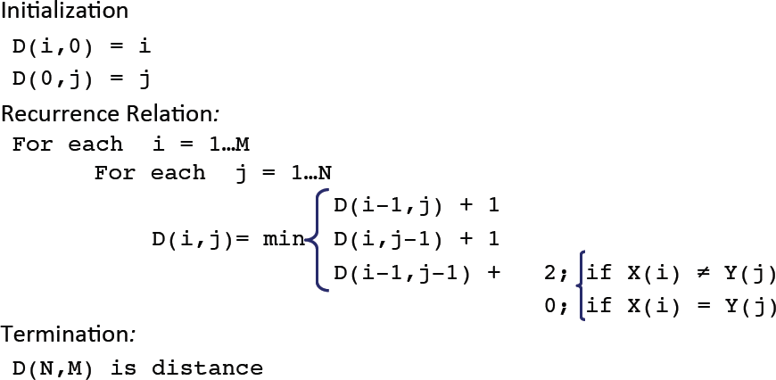
Dynamic Programming Algorithm
Week 2: Lecture 1

Slide 81
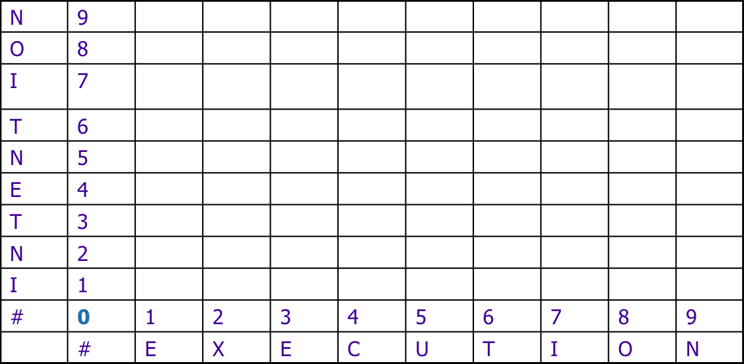
The Edit Distance Table
Week 2: Lecture 1
11 / 20

Slide 82
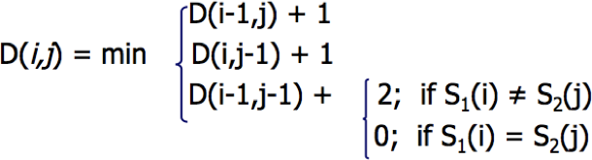
The Edit Distance Table
Week 2: Lecture 1
11 / 20

Slide 83
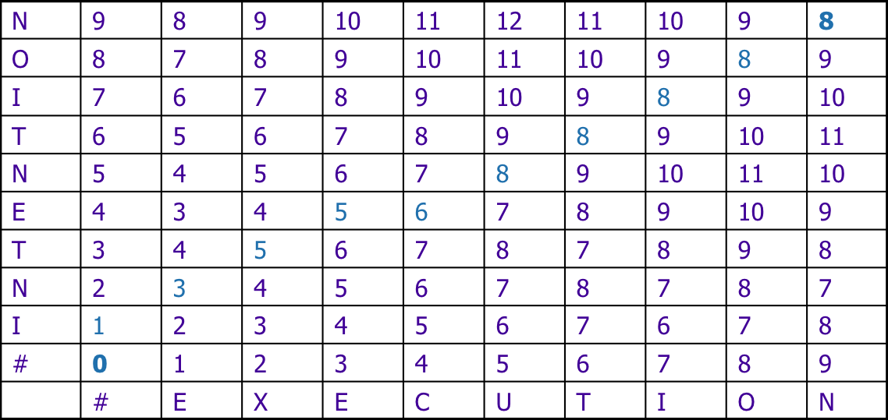
The Edit Distance Table
Week 2: Lecture 1

Slide 84
Computing Alignments
Computing edit distance may not be sufficient for some applications
⁾ We often need to align characters of the two strings to each other
We do this by keeping a “backtrace”
Every time we enter a cell, remember where we came from When we reach the end,
⁾ Trace back the path from the upper right corner to read off the alignment
Week 2: Lecture 1
13 / 20

Slide 85
The Edit Distance Table
Week 2: Lecture 1

Slide 86
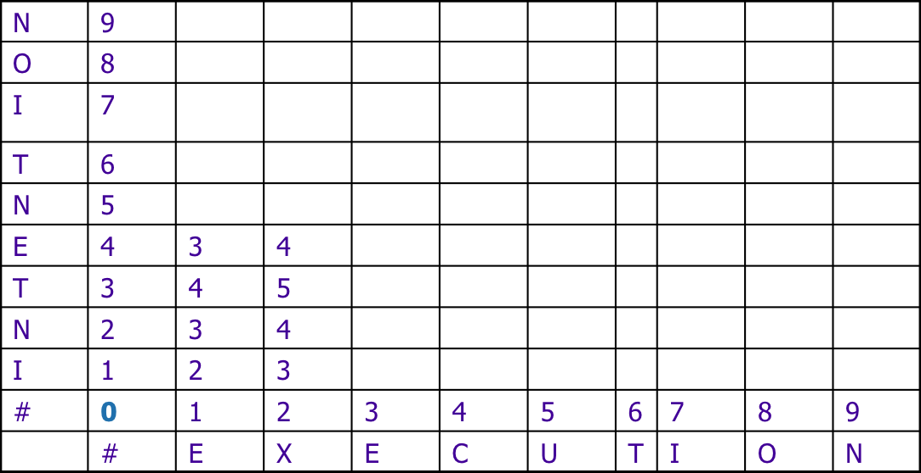
The Edit Distance Table
Week 2: Lecture 1

Slide 87
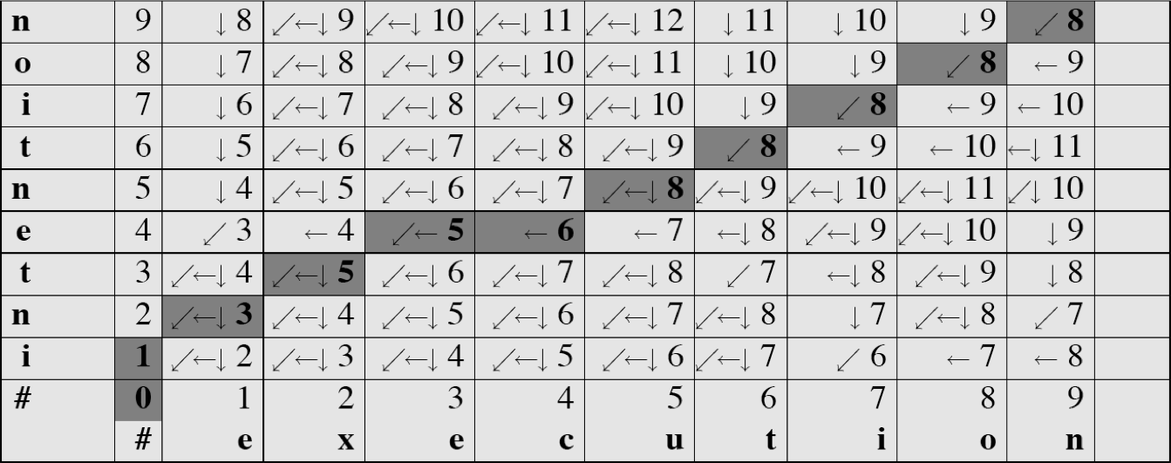
Minimum Edit with Backtrace
Week 2: Lecture 1

Slide 88
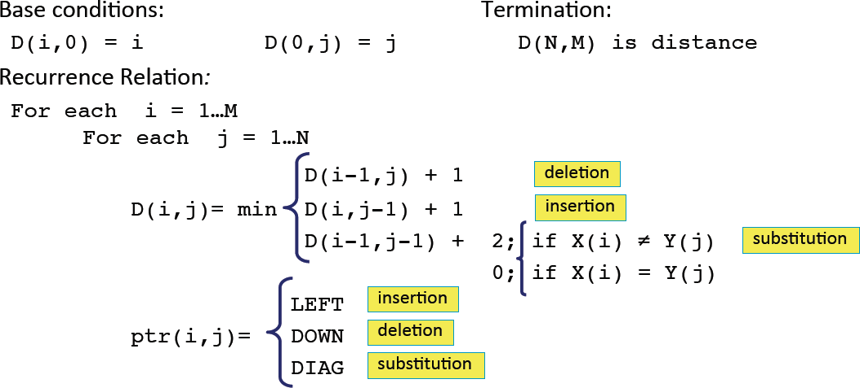
Adding Backtrace to Minimum Edit
Week 2: Lecture 1

Slide 89
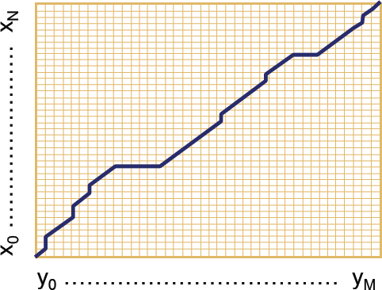
The distance matrix
Every non-decreasing path from (0,0) to (M,N) corresponds to an alignment of two sequences.
An optimal alignment is composed of optimal sub-alignments.
Week 2: Lecture 1
18 / 20

Slide 90
Result of Backtrace
Week 2: Lecture 1

Slide 91
Time O(nm)
Performance
Space O(nm)
Backtrace O(n + m)
Week 2: Lecture 1
20 / 20

Slide 92
Weighted Edit Distance, Other variations
Week 2: Lecture 2
1 / 12

Slide 93
Weighted Edit Distance
Why to add weights to the computation?
Some letters are more likely to be mistyped.

Slide 94
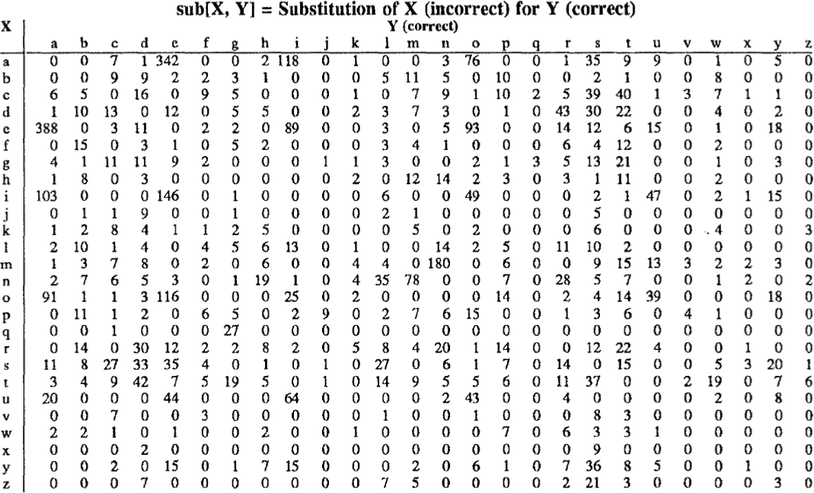
Confusion Matrix for Spelling Errors
Week 2: Lecture 2
3 / 12

Slide 95
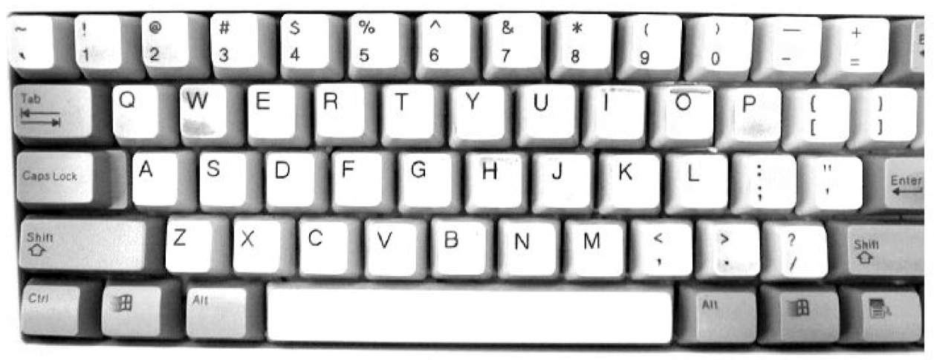
Keyboard Design
Week 2: Lecture 2
4 / 12

Slide 96
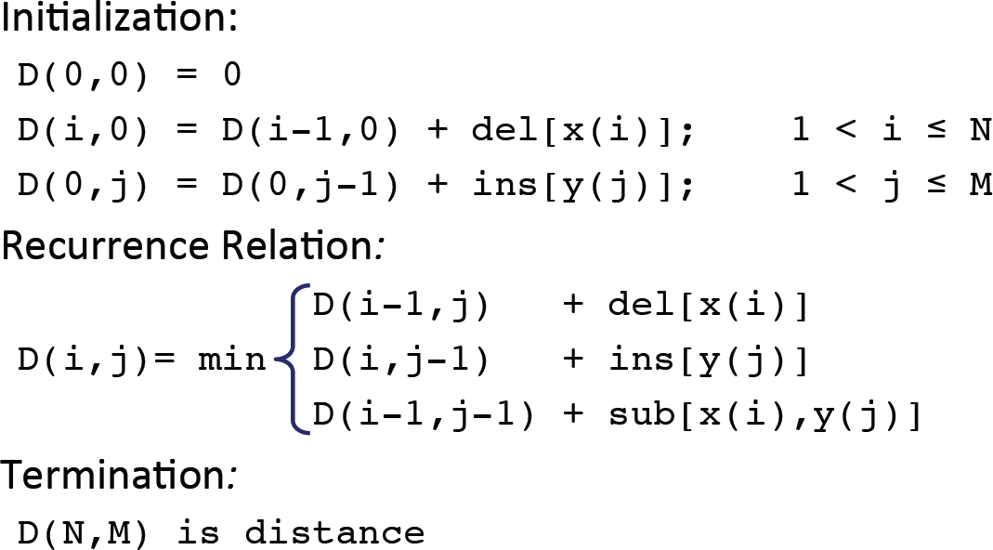
Weighted Minimum Edit Distance
Week 2: Lecture 2
5 / 12

Slide 97
How to modify the algorithm with transpose?
Transpose
transpose(x, y) = (y, x)
Also known as metathesis

Slide 98
How to modify the algorithm with transpose?
Transpose
transpose(x, y) = (y, x)
Also known as metathesis
Modification to the dynamic programmic algorithm
D(i − 1, j) + 1 (deletion)

D(i, j − 1) + 1 (insertion)

(

1 if (x[i] /= y[j])(substitution)
D[i][j] = min D(i − 1, j − 1)+
0 otherwise

D(i − 2, j − 2) + 1
(x[i] = y[j − 1] and x[i − 1] = y[j]

(transposition)
Week 2: Lecture 2
6 / 12

Slide 99
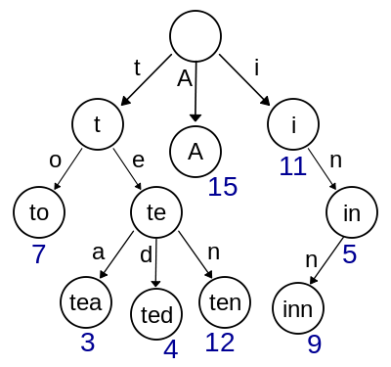
How to find dictionary entries with smallest edit distance?
Naïve Method
Compute edit ditance from the query term to each dictionary term – an exhaustive search
Can be made efficient if we do it over a trie structure
Week 2: Lecture 2
7 / 12

Slide 100
How to find dictionary entries with smallest edit distance?
Generate all possible terms with an edit distance <=2 (deletion +transpose + substitution + insertion) from the query term and search them in the dictionary
For a word of length 9, alphabet of size 36, this will lead to 114,324 terms to search for
For Chinese alphabet size is 70,000 (Unicode Han Characters)

Slide 101
How to find dictionary entries with smallest edit distance?
Symmetric Delete Spelling Correction
Generate terms with an edit distance <=2 (deletes) from each dictionary term (offline)
Generate terms with an edit distance <=2 (deletes) from the input terms and search in dictionary
Number of deletes within edit distance <=2 for a word of length 9 will be 45
A further check is required to remove the false positives

Slide 102
Spelling Correction
Types of spelling errors: Non-word Errors behaf -> behalf
Types of spelling errors: Real-word Errors
Typographical errors: three ->there
Cognitive errors (homophones): piece-> peace, too -> two

Slide 103
Non-word spelling errors
Non-word spelling error detection:
Any word not in a dictionary is an error
The larger the dictionary the better
Non-word spelling error correction:
Generate candidates: real words that are similar to the error word
Choose the best one:
1. I Shortest weighted edit distance
2. I Highest noisy channel probability

Slide 104
Real word spelling errors
For each word w, generate candidate set
Find candidate words with similar pronunciations
Find candidate words with similar spelling
Include w in candidate set
Choosing best candidate
Noisy Channel

Slide 105
Noisy Channel Model for Spelling Correction
Week 2: Lecture 3
1 / 17

Slide 106
Noisy Channel
We see an observation x of the misspelled word
Find the correct word w
wˆ = argmaxP(w|x)
w∈V
_{= argmax} P(x|w)P(w)
w∈V
P(x)
= argmaxP(x|w)P(w)
w∈V
Week 2: Lecture 3
2 / 17

Slide 107
Non-word spelling error: acress
Words with similar spelling
Small edit distance to error
Words with similar pronuncitation
Small edit distance of pronunciation to error
Damerau-Levenshtein edit distance Minimum edit distance, where edits are: Insertion, Deletion, Substitution, Transposition of two adjacent letters
Week 2: Lecture 3
3 / 17

Slide 108
Non-word spelling error: acress
Words with similar spelling: Small edit distance to error
Words with similar pronuncitation: Small edit distance of pronunciation to error.
Damerau-Levenshtein edit distance:
Minimum edit distance, where edits are:
Insertion, Deletion, Substitution,
Transposition of two adjacent letters

Slide 109
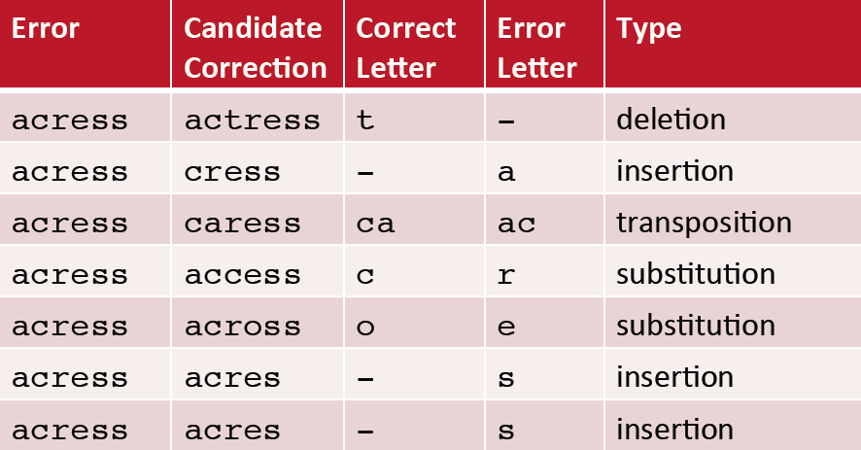
Words within edit distance 1 of acress
Week 2: Lecture 3
4 / 17

Slide 110
Candidate generation
80% of errors are within edit distance 1 Almost all errors within edit distance 2
Allow deletion of space or hyphen
thisidea → this idea inlaw → in-law
Week 2: Lecture 3
5 / 17

Slide 111
Computing error probability: confusion matrix
del[x,y]: count (xy typed as x) ins[x,y]: count (x typed as xy) sub[x,y]: count (x typed as y) trans[x,y]: count(xy typed as yx)
Insertion and deletion are conditioned on previous character
Week 2: Lecture 3
6 / 17

Slide 112
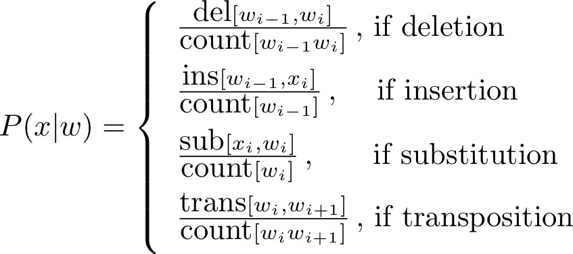
Channel model
Insertion and deletion are conditioned on previous character
Week 2: Lecture 3
7 / 17

Slide 113
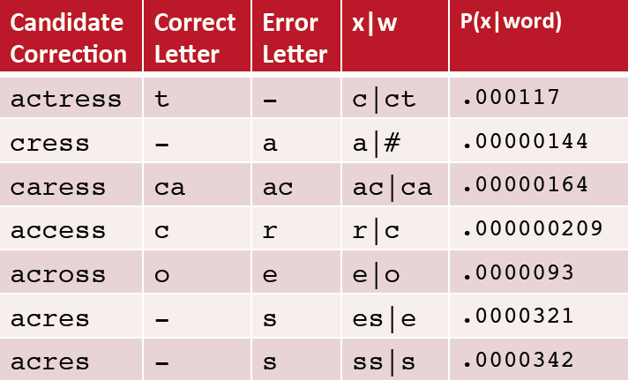
Channel model for acress
Week 2: Lecture 3
8 / 17

Slide 114
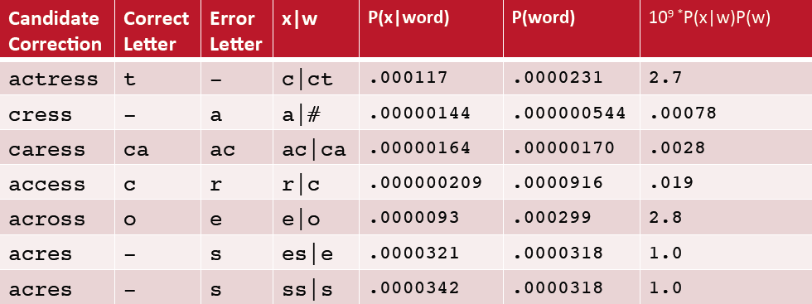
Noisy channel probability for acress
Week 2: Lecture 3
9 / 17

Slide 115
Using a bigram language model
“ ... versatile acress whose ...”
Counts from the Corpus of Contemporary American English with add-1 smoothing
P(actress|versatile) = 0.000021, P(across|versatile) = 0.000021
P(whose|actress) = 0.0010, P(whose|across) = 0.000006 P(“versatile actress whose”) = 0.000021 * 0.0010 = 210 x 10⁻¹⁰ P(“versatile across whose”) = 0.000021 * 0.000006 = 1 x10⁻¹⁰
Week 2: Lecture 3
10 / 17

Slide 116
Real-word spelling errors
The study was conducted mainly be John Black
The design an construction of the system
25-40% of spelling errors are real words

Slide 117
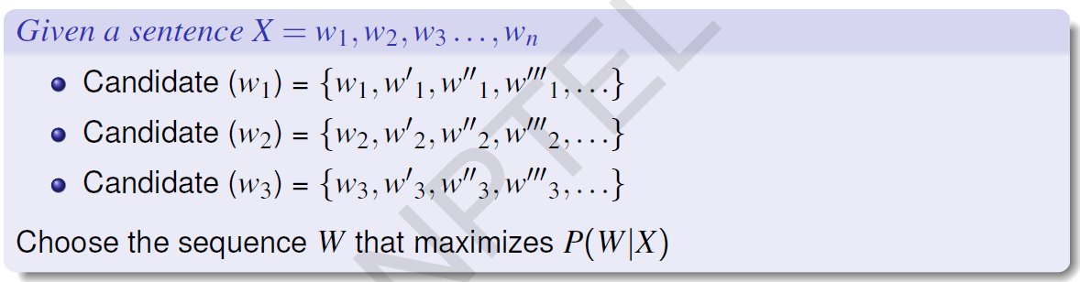
Noisy channel for real-word spell correction

Slide 118
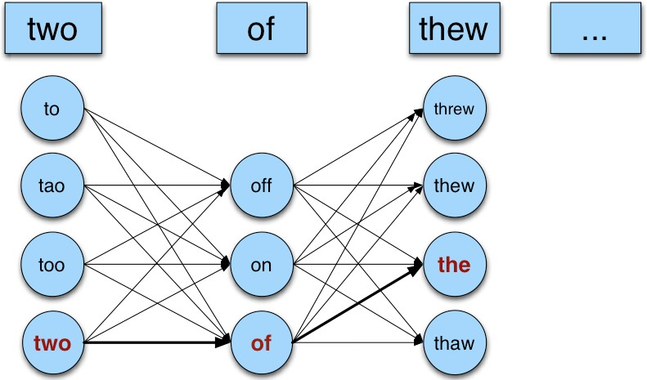
Noisy channel for real-world spell correction
Week 2: Lecture 3

Slide 119
N-Gram Models

Slide 120
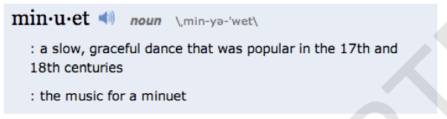
Context Sensitive Spelling Correction
The office is about fifteen minuets from my house
Use of language model
P(about fifteen minutes from) > P(about fifteen minuets from)

Slide 121
Probabilistic Language Models: Applications
Speech Recognition
P(I saw a van) >> P(eyes awe of an)
Machine Translation
Which sentence is more plausible in the target language?
P(high winds) > P(large winds)
Other Applications
Context Sensitive Spelling Correction
Natural Language Generation
...

Slide 122

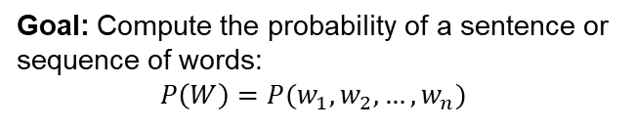
Probabilistic Language Modeling
Goal: Compute the probability of a sentence or sequence of words:
$$P\left(W\right)=P(w_{1},w_{2},…,w_{n})$$
Related Task: probability of an upcoming word:
$$P(w_{4}|w_{1},w_{2},w_{3})$$
A model that computes either of these is called a language model

Slide 123
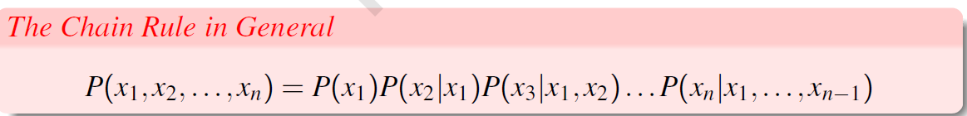

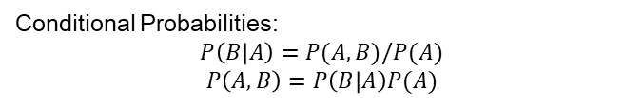
The Chain Rule
Conditional Probabilities:
$$P\left(B | A\right)=P(A,B)/P(A)$$
$$P\left(A,B\right)=P\left(B | A\right)P(A)$$
More Variable:
$$P\left(A,B,C,D\right)=P\left(A\right)P\left(B | A\right)P\left(C | A,B\right)P(D|A,B,C)$$

Slide 124
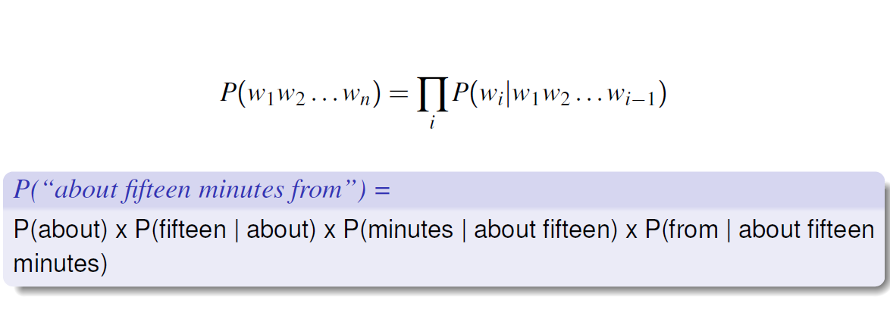
Probability of words in sentences

Slide 125
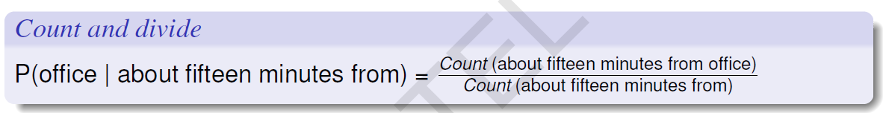
Estimating These Probability Values

Slide 126
N-Gram Models
P(office | about fifteen minutes from)
An N-gram model uses only N − 1 words of prior context.
Unigram: P(office) Bigram: P(office | from)
Trigram: P(office | minutes from)
Markov model and Language Model
An N-gram model is an N − 1-order Markov Model
Week 2: Lecture 4
12 / 24

Slide 127
N-Gram Models
We can extend to trigrams, 4-grams, 5-grams In general, an insufficient model of language:
language has long-distance dependencies:
“The computer which I had just put into the machine room on the fifth floor crashed.”
In most of the applications, we can get away with N-gram models
Week 2: Lecture 4
13 / 24

Slide 128
Estimating N-grams probabilities
Maximum Likelihood Estimate
Value that makes the observed data the “most probable”
count(w , w )
P(w |w ) =
i−1 i
i i−1
count(w_{i−1})
c(w , w )
P(w |w ) =
i−1 i
i i−1
c(w_{i−1})
Week 2: Lecture 4
14 / 24

Slide 129
An Example
<s>I am here </s>
<s>who am I </s>
<s>I would like to know </s>
c(w , w )
P(w |w ) =
i−1 i
i i−1
c(w_{i−1})
Week 2: Lecture 4
15 / 24

Slide 130
An Example
<s>I am here </s>
<s>who am I </s>
<s>I would like to know </s>
c(w , w )
P(w_{i}|w_{i−1}) =
Estimating bigrams
i−1 i
c(w_{i−1})
P(I|<s>) =
P(</s>|here) = P(would | I) = P(here | am) = P(know | like) =
Week 2: Lecture 4
15 / 24

Slide 131
An Example
<s>I am here </s>
<s>who am I </s>
<s>I would like to know </s>
c(w , w )
P(w_{i}|w_{i−1}) =
Estimating bigrams
i−1 i
c(w_{i−1})
P(I|<s>) = 2/3
P(</s>|here) =1 P(would | I) = 1/3 P(here | am) = 1/2 P(know | like) = 0
Week 2: Lecture 4
15 / 24

Slide 132
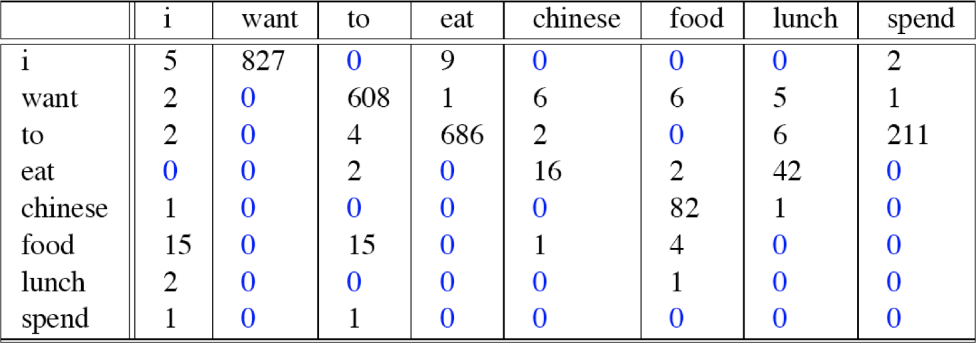
Bigram counts from 9222 Restaurant Sentences
Week 2: Lecture 4

Slide 133
Computing bigram probabilities
Normlize by unigrams
Week 2: Lecture 4
17 / 24

Slide 134
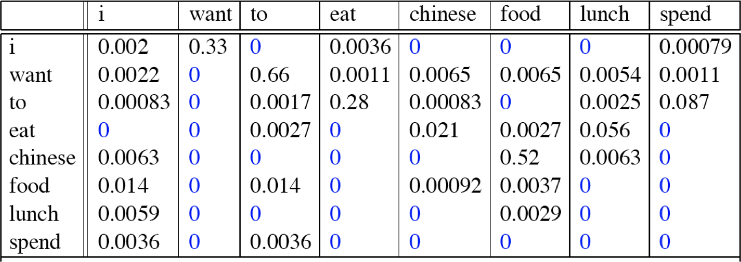
Computing bigram probabilities
Normlize by unigrams
Bigram Probabilities
Week 2: Lecture 4
17 / 24

Slide 135
Evaluating Language Model
Does it prefer good sentences to bad sentences?
Assign higher probability to real (or frequently observed) sentences than ungrammatical (or rarely observed) ones
Training and Test Corpora
Parameters of the model are trained on a large corpus of text, called
training set.
Performance is tested on a disjoint (held-out) test data using an
evaluation metric
Week 2: Lecture 5
2 / 16

Slide 136
Extrinsic evaluation of N-grams models
Comparison of two models, A and B
Use each model for one or more tasks: spelling corrector, speech recognizer, machine translation
Get accuracy values for A and B Compare accuracy for A and B
Week 2: Lecture 5
3 / 16

Slide 137
Intrinsic evaluation: Perplexity
Intuition: The Shannon Game
How well can we predict the next word?
I always order pizza with cheese and . . . The president of India is . . .
I wrote a . . .
Unigram model doesn’t work for this game.
A better model of text
is one which assigns a higher probability to the actual word
Week 2: Lecture 5
4 / 16

Slide 138
Perplexity
The best language model is one that best predics an unseen test set
Perplexity (PP(W))
Perplexity is the inverse probability of the test data, normalized by the number of words:
PP(W) = P(w w . . . w )
−
1
N
1 2 N
Applying chain Rule
1
N
∏
1
PP(W) =
P(w |w . . . w )
i 1 i−1
For bigrams
1
N
∏
1
PP(W) =
P(w |w )
i i−1
Week 2: Lecture 5
5 / 16

Slide 139
Example: A Simple Scenario
Consider a sentence consisting of N random digits
Find the perplexity of this sentence as per a model that assigns a probability p = 1/10 to each digit.
PP(W) = P(w w . . . w )
−
1
N
1 2 N
! 1
N
N
−
1
=
10
1
−1
=
10
= 10
Evaluation of Language Models, Basic Smoothing
Week 2: Lecture 5
6 / 16

Slide 140
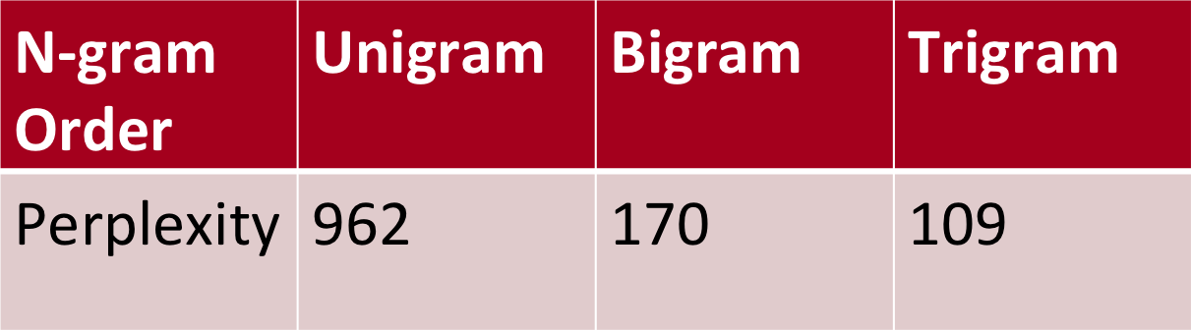
Lower perplexity = better model
WSJ Corpus
Training: 38 million words
Test: 1.5 million words
Unigram perplexity: 962?
The model is as confused on test data as if it had to choose uniformly and independently among 962 possibilities for each word.
Week 2: Lecture 5
7 / 16

Slide 141
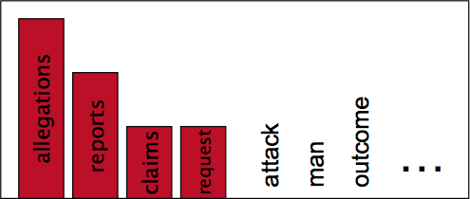

Language Modeling: Smoothing
With sparse statistics
Evaluation of Language Models, Basic Smoothing
Week 2: Lecture 5
12 / 16

Slide 142


Language Modeling: Smoothing
With sparse statistics
Steal probability mass to generalize better

Slide 143
Laplace Smoothing (Add-one estimation)
Pretend as if we saw each word (N-gram) one more time that we actually did
Just add one to all the counts!
MLE estimate for bigram: P_{MLE}(w_{i}|w_{i−1}) =
c(w ,w )
i−1 i
c(w_{i−1})
Add-1 estimate: P_{Add−1}(w_{i}|w_{i−1}) =
c(w ,w )+1
i−1 i
c(w_{i−1})+V
Week 2: Lecture 5
13 / 16

Slide 144
Reconstituted counts as effect of smoothing
Effective bigram count (c∗(w_{n−1}w_{n}))
c∗(w_{n−1}w_{n}) ₌ c(w_{n−1}w_{n}) + 1 c(w_{n−1}) c(w_{n−1}) + V

Slide 145


Comparing with bigrams: Restaurant corpus
Week 2: Lecture 5
15 / 16

Slide 146
More general formulations: Add-k
c(w ,
w ) + k
P
(w |w ) =
i−1 i
Add k
— i i−1
c(w_{i−1}) + kV
c(w_{i−1}, w_{i}) + m( ¹ )
PAdd−k(wi|wi−1) =
Unigram prior smoothing:
V
c(w_{i−1}) + m
c(w
, w ) + mP(w )
P (w |
w ) =
i−1 i
i
UnigramPrior i i−1
c(w_{i−1}) + m
A good value of k or m?
Can be optimized on held-out set
Week 2: Lecture 5
16 / 16

